Slide 1
Impact of Carbon Emissions
Has the sale of EVs lowered Carbon Emissions?
If so, by how much?

Slide 2

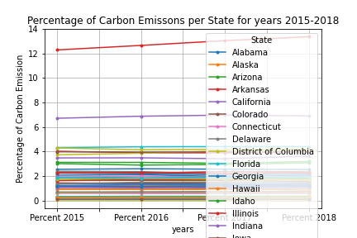
Carbon Emissions for 2015-2018
Two visible outliers, Texas and California
Texas has the highest percentage of carbon emissions as well as the only one with a significant upward trend
California also has high CO2 emissions and a slight upward trend
Fig. 1 Shows the percentage of CO2 emissions per year.
Fig. 2 Shows the percentage of CO2 emissions per state per year.

Slide 3
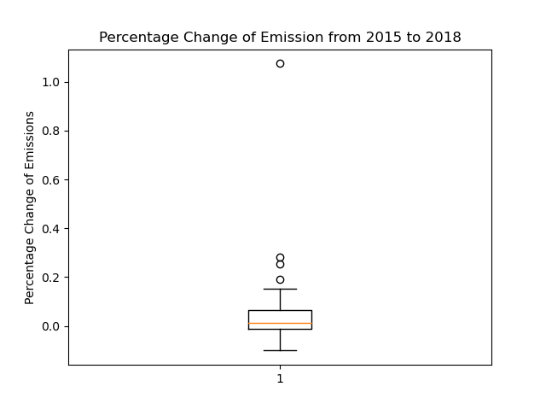
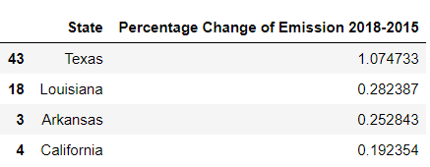
Percentage of Change – Carbon Emission
Texas, Louisiana, Arkansas and California are outliers, having a higher percentage of change in CO2 emissions
Fig. 3 Shows the percentage change in CO2 emissions.
Fig. 4 Lists the outliers of highest CO2 Emissions

Slide 4
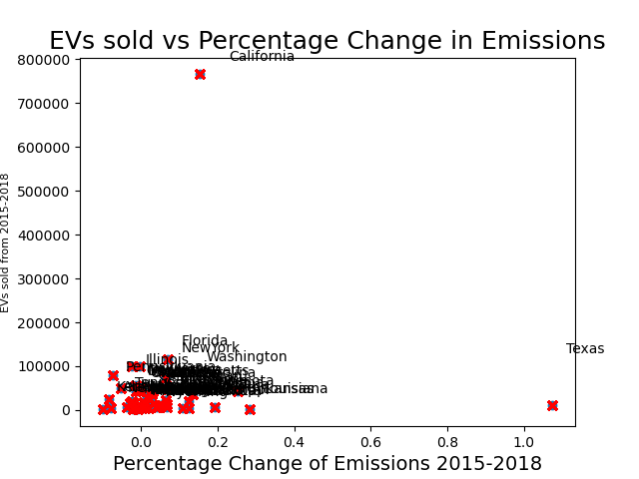
Sales of Electric Vehicles vs Emissions
In California even with high EV sales, CO2 emissions were still high and were an outlier
Texas has low EV sales, CO2 emissions were high
Fig. 5 Shows the percentage change of CO2 emissions and the electric vehicle sales per state.

Slide 5
Conclusion
There is not a strong correlation shown of Carbon Emissions and the sale of electric vehicles.
Overall according to Figure 1 CO2 emissions have declined since 2015.
This is not what we were expecting.
Big push for Electric Vehicles – not making large difference in CO2 emissions

